Slide 1
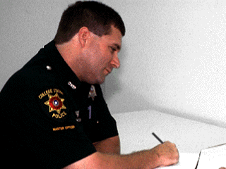



Session 26
Preparing the Narrative Report

Slide 2
Learning Objectives
Discuss essential elements of the drug influence evaluation report
Prepare a clear and concise drug influence evaluation report

Slide 3
Drug Influence Evaluation Report
Complete, clear, convincing
Well-written
Descriptive, detailed and complete
Organized, clearly documented, and compelling

Slide 4
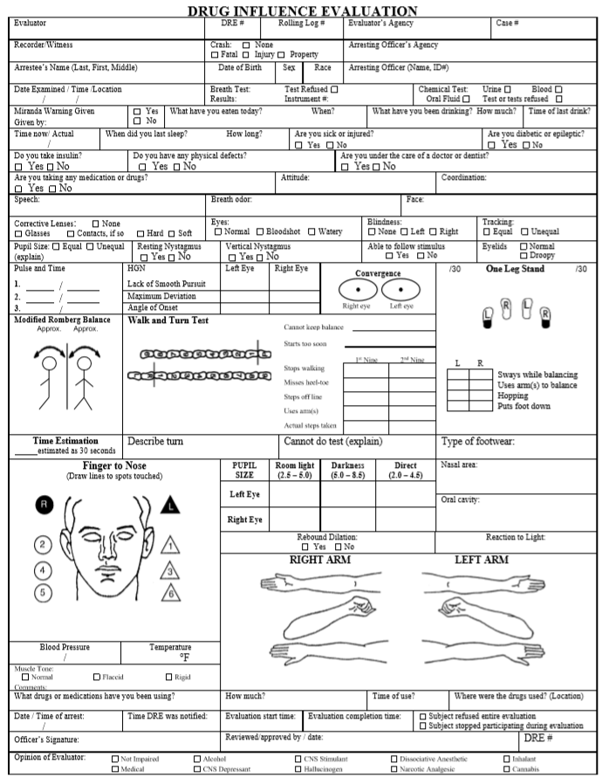
Sample Drug Influence Evaluation Facesheet

Slide 5
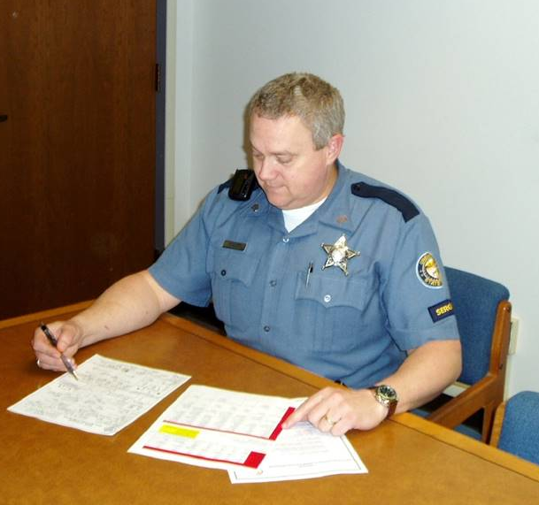
Drug Influence Evaluation Facesheet

Slide 6
Drug Influence Evaluation Facesheet
Modified Romberg Balance
Approx.
Approx.
Convergence
Right eye
Left eye
Time Estimation
estimated as 30 seconds

Slide 7
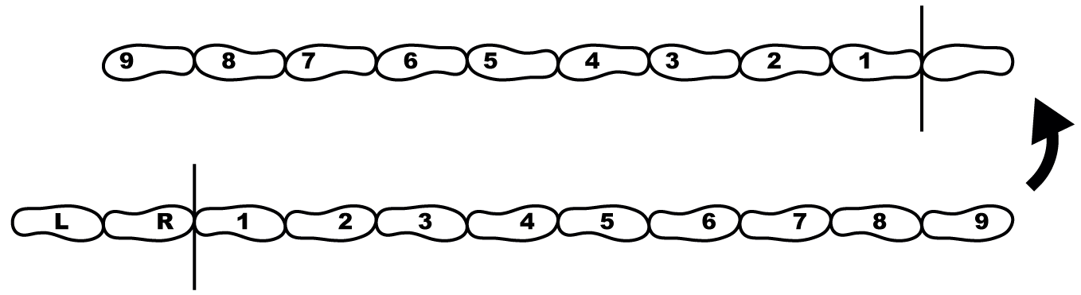
Drug Influence Evaluation Facesheet
Recording Walk and Turn
Test Results
Walk and Turn Test
Cannot keep balance
Starts too soon
 | 1st Nine | 2nd Nine
Stops walking
Misses heel-toe
Steps off line
Uses arm(s)
Actual Steps taken
Describe turn
Cannot do test (explain)

Slide 8
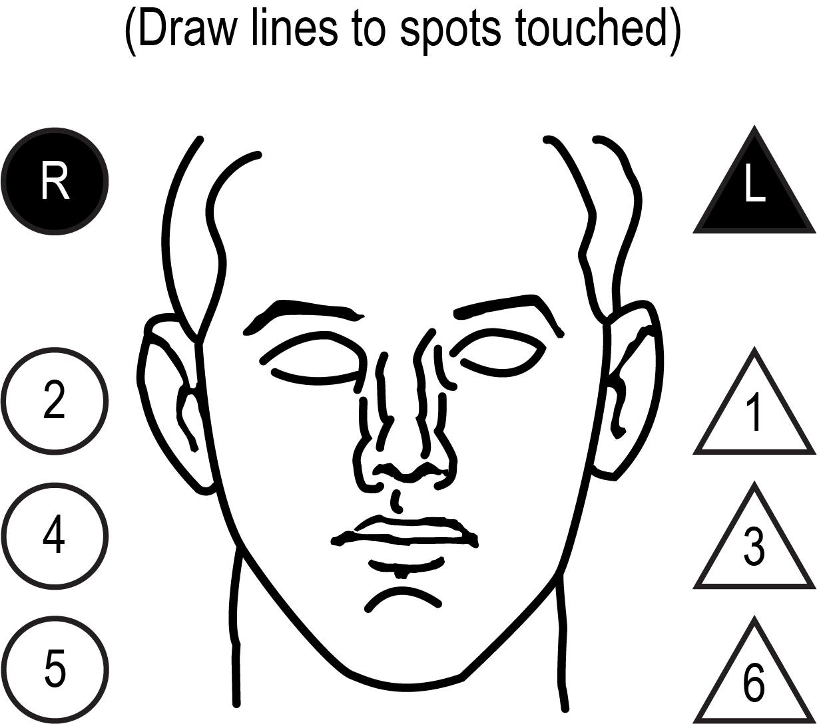

Drug Influence Evaluation Facesheet
Recording One Leg Stand
and Finger to Nose tests
/30 | One Leg Stand |  |  | /30
L | R
 |  | Sways while balancing
 |  | Uses arm(s) to balance
 |  | Hopping
 |  | Puts foot down
Type of footwear:

Slide 9
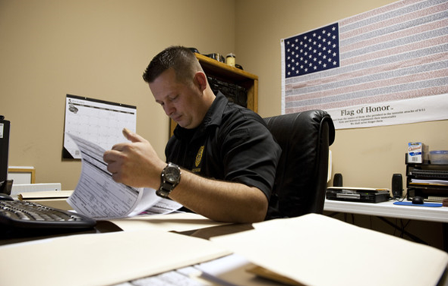
Drug Influence Evaluation Narrative Report Components

Slide 10
Sample Report

Slide 11
Questions?

